Slide 1
What is 'Scenario Analysis' Definition: Scenario Analysis is a process to ascertain and analyze possible events that can take place in the future. This is an important tool in the world of finance and economics, and is used extensively to make projections for the future. Description: This constitutes an important tool for decision making in the financial world, be it at the macro or the micro level. It is used extensively in the financial world for forecasting and analyzing possible future events. Mathematics/statistics play a crucial role in such analyses. Based on the conclusions arrived through the analysis, financial institutions prepare their action plan for the future and build their portfolios.

Slide 2
Steps for Risk Assessment
What can go wrong that could lead to an outcome of hazard exposure? (identification and characterization of risk)
2. How likely is this to happen? (quantification of risk, likelihood, and magnitude.
3. If it happens, what are the consequences? scenarios are constructed and the ways and means of facing the consequences are designed.

Slide 3
FMEA - Failure mode and effect analysis is defined as a systematic tool to
Identify possible failure modes in the products/process,
(b) to understand failure mechanism (process that leads to failure),
(c) risk analysis, and
(d) plan for action on elimination or reduction of failure modes

Slide 4
Stages of FMEA
Identifying possibilities and defining the scope. It includes function, possible failure mode, causes and effects of failure mode and detection/ prevention of failure mode.
Measuring the volume of risk involved from the failure modes identified. IT includes the probability of cause and occurrence, severity of effects and effectiveness of control to prevent causes.
Classification of severity of effects and the solution for the causes of high risk.
Revalidation of the above procedure after corrective and preventive actions are implemented.

Slide 5
Fault-tree Analysis: This is a qualitative method and was originated by Bell Telephones. It is technology-based deductive logic. The failure (undesirable event) is initially defined, and the events (causal relationships) leading to that failure are identified at different components level. This method can combine hardware failures and human failures .
Example 3: An automobile car does not start. The advantages of FTA are (a) the primary cause can be located easily, and (b) It is useful in emergent situations i.e., a fire-fighting approach.

Slide 6
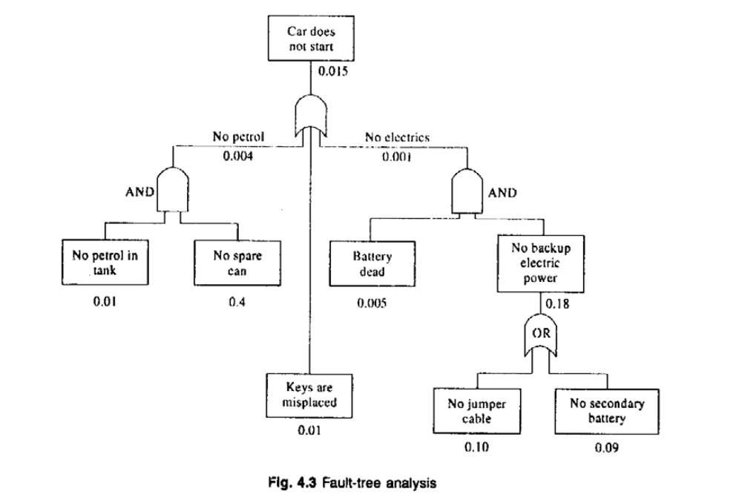
Fault-tree Analysis

Slide 7
Event tree analysis
This methods explains the sequence of outcome which may arise after the occurrence of a selected initial event. This methods uses inductive logic.
Inductive logic is a method of drawing conclusions by going from the specific to the general. Its also known as bottom up reasoning.
It is mainly used for consequence analysis and in identifying the potential hazardous existing situation in the system. It is the inverse of the FTA.
ETA allows the observer to proceed forward in time from potential component failures to final accidents.
Example: going late for duty – the events are listed, arranged chronologically and in separate clusters, to include only that are relevant and important.

Slide 8
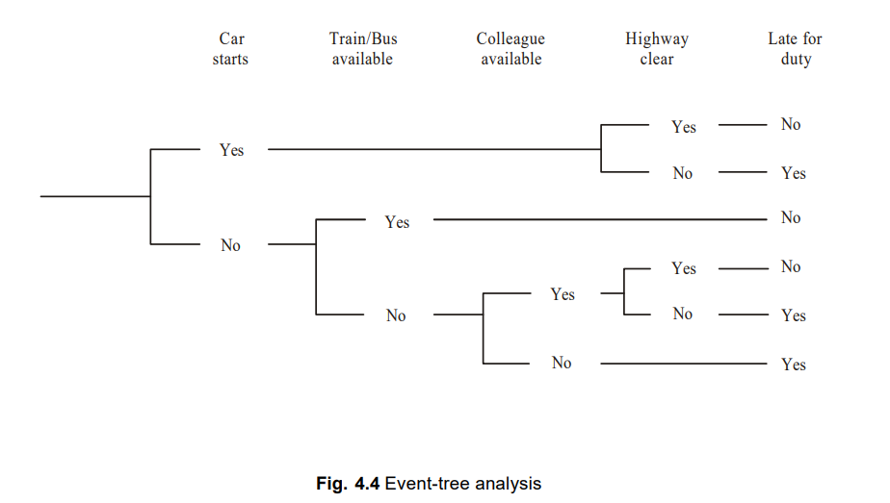
Event tree analysis

Slide 9
RISK BENEFIT ANALYSIS
It is a technique used to analyze the risk in a project and to determine the project should be carried out or not.
It is a comparison between the potential risks of a situation and its potential benefits.
The results can fall in favor of the risks or in favor of the benefits, depending upon the situation.
Risk does not need to be catastrophic to be considered one it can be any undesirable outcome.
Why we do risk benefit analysis:
1. what are the benefits of a project or product?
2. is the project or product worth the risk connected with its use?
3. do benefits outweigh the risk?

Slide 10
Conceptual Difficulties in Risk Benefit Analysis
1. Difficult to quantify - because both lie in the future and both are
associated with uncertainties.
2. Difficult to predict who is going to take the risk
It is difficult to express both risk and benefits in common set of units.
eg. When the risk can be expressed and measured in one set of units ( eg. Travelling in airways) then very difficult to do risk benefit analysis. Here risk benefit analysis is used to judge the relative merits of different designs)

Slide 11
Ethical Implications on Risk Benefit Analysis
Points to remember while performing risk benefit analysis:
a. under what conditions, someone in society is entitled to impose a risk on someone else on behalf of a supposed benefit to others?
b. how can we consider the worst case scenario of persons exposed to maximum risk while they are also obtaining only minimum benefits? Are their rights violated? Are they provide safer alternatives?

Slide 12
Personal risk
If sufficient information is given to a person, then he can be able to decide whether to participate in a risk activity or not.
Many experiments have concluded that individuals are more willing to face voluntary risks than involuntary risks, even when the voluntary risk are more voluntary risk are more harmful the involuntary ones.
Personal risk are difficult to assess especially if they are involuntary personal risk.
Eg. Person living near a chemical plant voluntarily or involuntarily and a person working in a nuclear power plant or oil refinery plant.
The quantification in assessing personal safety and risk very difficult to estimate.

Slide 13
Cont.,
While assessing the personal risk, one should consider the following ethics estimate.
1. how to access the money value of an individuals life?
2. on what basis, the compensation for a risk can be decided.
3. Is the compensation for a risk by an amount based on the exposure tolerance of the average person justifiable?
4. what will be the compensation if the tolerance level of the person is before or above the average tolerance level?
In order to minimize the above difficulties in assessing personal risk, the analysts employ all the available quantitative measures such as
1. making judgements on the basis of the amount of life insureance taken out by an individual
2. assessing a hazardous job by looking at the increased wages a worker demands to carry out the task.

Slide 14
Public Risk and Public Acceptance
Risks and benefit to the public at large can be more easily determined than the personal risks and benefits. Because individuals differences tend to even out as large numbers of people are considered.
Assessment studies relating to technological safety can be conducted in a better manner for public risk than for personal risk, as statistical parameters take on greater significance.
America’s national highway traffic safety administration has emphasized:
1. A value for human life can be estimated based on loss of future income and other costs associated with an accident.
2. An estimate of quantifiable losses in social welfare ( resulting from a fatality) is not based on the maximum expenditure allocated to save a life.

Slide 15
Becoming A Responsible Engineer Regarding Risk
The engineers can provide background material to prove the faulty positions.
Engineers should actively participate in the debates related to safety and risk.
Engineers should always insist on meaningful numbers and figures when assessing safety and risk.
Engineers should recognize the previously mentioned difficulties with measuring risks and benefits in absolute terms.
Engineers should not be influenced by an influential lobby or trade organisations.
Engineers need to be sensitive to various qualitative value judgements related with human and ethical values.
Engineers should be aware at the legal liabilities regarding risk.

Slide 16
Reducing Risk
What is risk management: “The eradication or minimization of the adverse effects of the pure risks to which an organization is exposed”
How to reduce risk:
Risk Identification: risk can be identified by various techniques such as physical inspection, safety, audit, job safety analysis, management and worker discussions and historical data analysis.
Risk Evaluation: risk can be measured on the basis of
a. economic consideration
b. social consideration and
c. legal consideration

Slide 17
Cont.,
Economic and social considerations include financial aspects, uninsured cost of accidents, insurance premium, overall effect on the profitability and possible loss of production.
Legal considerations include possible constraint from compliance with health and safety legislation. Code of practice, guidance notes and accepted standards, fire prevention, pollution and product liability.
3. Risk control:
a) Risk avoidance: it refers to the conscious decision by the management to avoid completely a particular risk by discontinuing the operation producing the risk.
b) Risk retention: it refers to retaining a particular risk for which any consequent loss in financed by the organization.
c) Risk Transfer: it refers to the legal assignment of the cost certain potential losses from one party to another (eg. Insurance)
d) Risk Reduction: it refers to the reduction or elimination of all aspect of accidental loss that lead to a wastage of an organisations assets.

